Slide 1


Charting An Intentional Pathway to College Success
Presented by: Truman Glenn
Compass Collegiate Advisor Services
compasscollegiateadvisor@gmail.com

Slide 2

Purpose
Matthew 25:14-30 (Parable of the Talents)
Jesus teaches that God expects us to develop and faithfully use what He has entrusted to us. This can include talents, abilities, opportunities, and education.

Slide 3
Purpose
Serving and being for the next generation is my passion.
Help students navigate admissions, financial aid, and course planning.
Guide high school students and non-traditional students to take ownership of their future.
Help the next generation navigate the entire college preparation and application journey.

Slide 4
About Me
Serving and being a disciple of Christ is at the
center of my life.
“Whatever you are able to do, do it with all your strength.” Ecclesiastes 9:10
“Do your work wholeheartedly, as if working for God.” Colossians 3:23
Proud father of Preston and Lily who attend Summit Christian Academy.
Over my 25+ years working in Higher Education, I have worked for:
  Texas A&M University/Texas A&M University at Galveston
  University of Houston – Main Campus
  The University of Texas at Austin
  Texas State University (current employed leading Veteran Affairs)

Slide 5
Work Experience
Work experience includes:
  Making school admissions decisions.
  Created/managed a Texas A&M University’s Apply Texas application.
  Processed financial aid, managing scholarship awarding, and processing GI Bill / TX Hazlewood benefits for Veterans and their dependents.
  Published school catalogs.
  Networked with college recruiters, admissions, financial aid, and registrar professionals within community colleges, private schools, and public universities across Texas throughout my career.

Slide 6
Why is A Collegiate Planning Checklist Important?
Understanding your path.
Time management improvement with realistic goals broken up over each high school year.
Understand and track college readiness milestones.
Being intentional over time to create a strong and competitive college application.

Slide 7
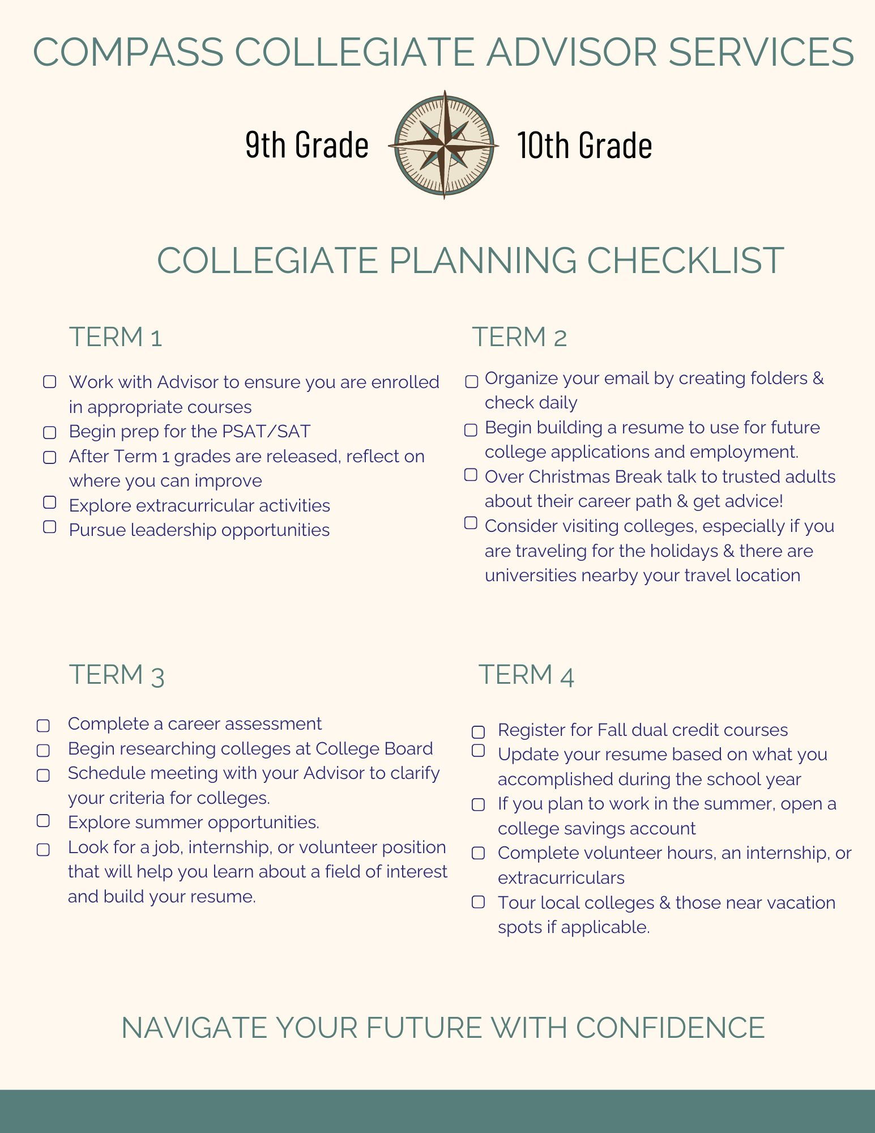

Slide 8
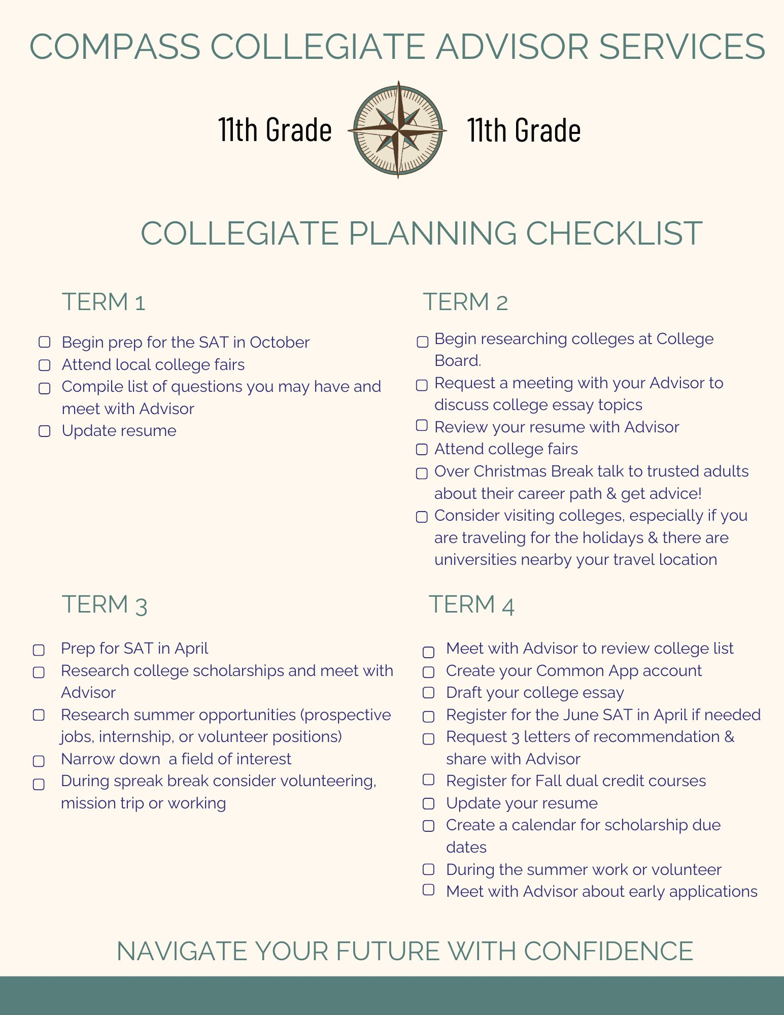

Slide 9
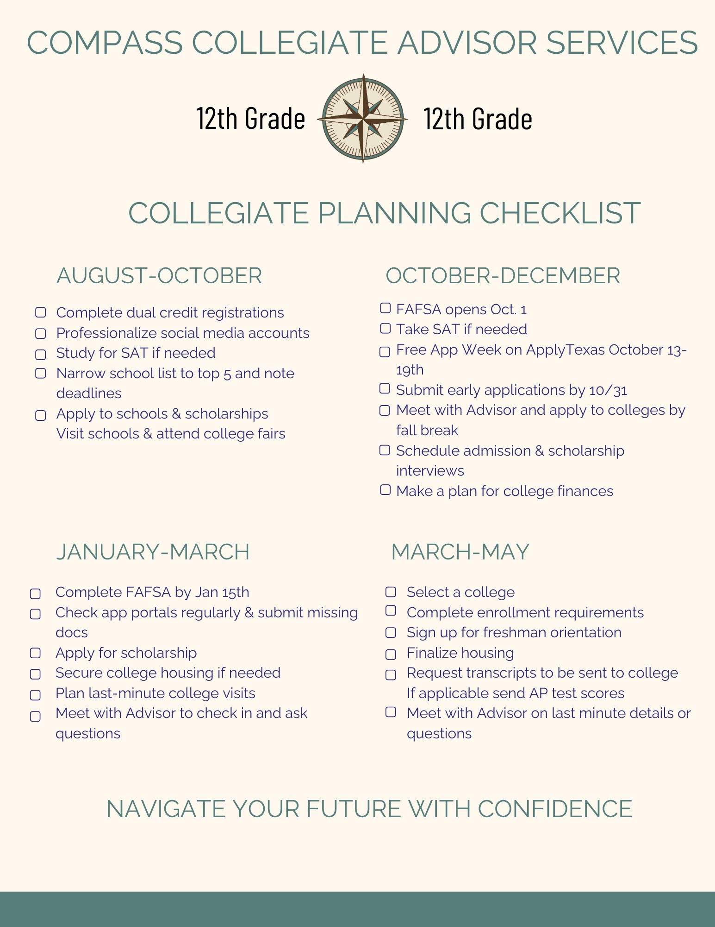

Slide 10
What Does A Collegiate Planning and Admissions Assistant Do?
Guide students through self-discovery and goal setting.
Assist with college research to best match student preferences and specialty considerations.
Academic planning and course strategy both in high school and college.
Extracurricular strategy and resume development.
Planning for standardized testing.
Application management and timeline tracking
Essay coaching and personal story development.
Letter of recommendation strategy.
Financial aid and scholarship guidance.
Final decision support.
Facilitate conversations regarding family support, expectations, school financing, and student responsibility.

Slide 11

Follow-up Questions?
How to Reach Me
How best to pursue additional help with Compass Collegiate Advisor Services:
Email:
compasscollegiateadvisor@gmail.com
Schedule an appointment:
http://calendly.com/compasscollegiateadvisor
Visit our website:
**************
Scan QR code to reach out directly via WhatsApp:

